Slide 1


HR Analytics Project

Slide 2
PROJECT SUMMARY
Project Title - HR Analytics
Presentation Outline
• Introduction
• Objectives
• Methodology
• KPI’s
• Dashboard
• Recommendation
• Conclusion
Data Size :- 50k Rows.
Timeline-
The timeline for project is scheduled from 22\06\2024 to 20\07\2024.

Slide 3
Project Overview
In this project, we have used different types of analytical tools like Excel, Tableau, Power BI, SQL.
We have created different dashboards on Lead and Opportunity Tables.
Also, we have described various types of Key Performance Indicators (KPIs)

Slide 4
Introduction:
HR analytics involves the collection and analysis of HR related data, including employee data, performance metrics, and other relevant data points. By using advanced analytical tools and techniques, HR analytics provides valuable insights into HR processes and trends, enabling organizations to make more informed decisions about their employees and improve overall performance.
Objective:
The aim of this project is to analyze employee retention and attrition rates with the organization and provide insights to the HR team for developing effective retention strategies. Through data analysis and visualizations, we will identify factors that contribute to :
Employee attrition.
Evaluate the effectiveness of existing retention strategies.
To verify the satisfaction level of employee in the organization.
Provide recommendations to improve employee retention.

Slide 5
Methodology
• Data cleaning process :
Before modelling , we implement a thorough data cleaning process to ensure the accuracy and reliability of the dataset. This involves handling missing values, removing duplicates, and addressing any inconsistencies in the data.
• Feature engineering :
During the data modelling phase, we focus on feature engineering to extract relevant insights from the dataset. This involves creating new features, transforming existing ones, and selecting the most influential variables for the model.
Model selection and validation :
We employ a rigorous approach to model selection and validation, utilizing techniques such as
Cross-validation and ensemble methods to ensure the robustness and generalizability of the model's
Performance.

Slide 6
KPI’s
➢Average attrition rate for all Departments
➢Average hourly rate of Male Research Scientist
➢Attrition rate Vs Monthly Income stats
➢Average working years for each Department
➢Job role Vs Work life balance
➢Attrition rate Vs Years Since last promotion

Slide 7
KPI 1 : Average Attrition rate for all Departments
This KPI is to find out the relationship between each department and its attrition rate.
Here in this KPI Average Attrition Rate for all department Based on our analysis and visualization,
1 )Highest attrition rate is in the research & development department that is 51.21%
2) Lowest attrition is in the Hardware department that is 49.44%

Slide 8
KPI 2 : Average Hourly Rate Of Male Research Scientist
Here in this kpi average hourly rate of Male Research Scientist in all the departments which is 114.

Slide 9
KPI 3 : Attrition rate Vs Monthly Income stats
in this KPI Attriton rate v/s Monthly income stats
Based on our analysis and visualization
Hardware Department has the lowest attrition rate of 49.44%, with an average monthly income of 26,028.
On the other hand, Research and Development Department has the highest attrition rate of 51.21%, with an average monthly income of 25,796.

Slide 10
KPI 4 : Average working years for each Department
in this KPI Average Working Years For each Department
1) Highest Avg. working years is in Software department that is 20.65.
2) Lowest Avg. working years is in Research & Development department 20.30

Slide 11
KPI 5 : Job role Vs Work life balance
Most of Job Role gives average of 2.5 Work life balance out of 4.

Slide 12
KPI 6 : Attrition Rate v/s Years Since Last Promotion
In this KPI Attrition Rate Vs Years Since Last Promotion We got
1)Average Attrition rate in all the Job role is around 50%
2)Highest Attrition Rate is in HR role that is 50.57% with Average of 5.88 Years Since Last Promotion
3)Lowest Attrition Rate is in Research Scientist role that is 48.91% with Average of 5.85 Years Since Last Promotion.

Slide 13
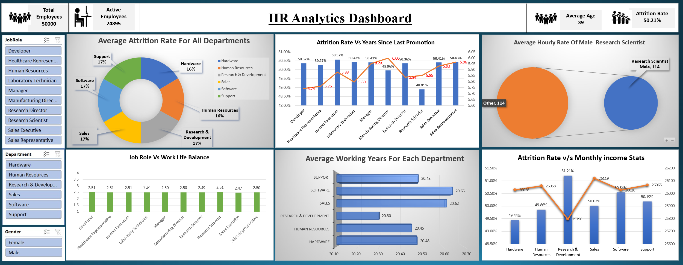

Slide 14
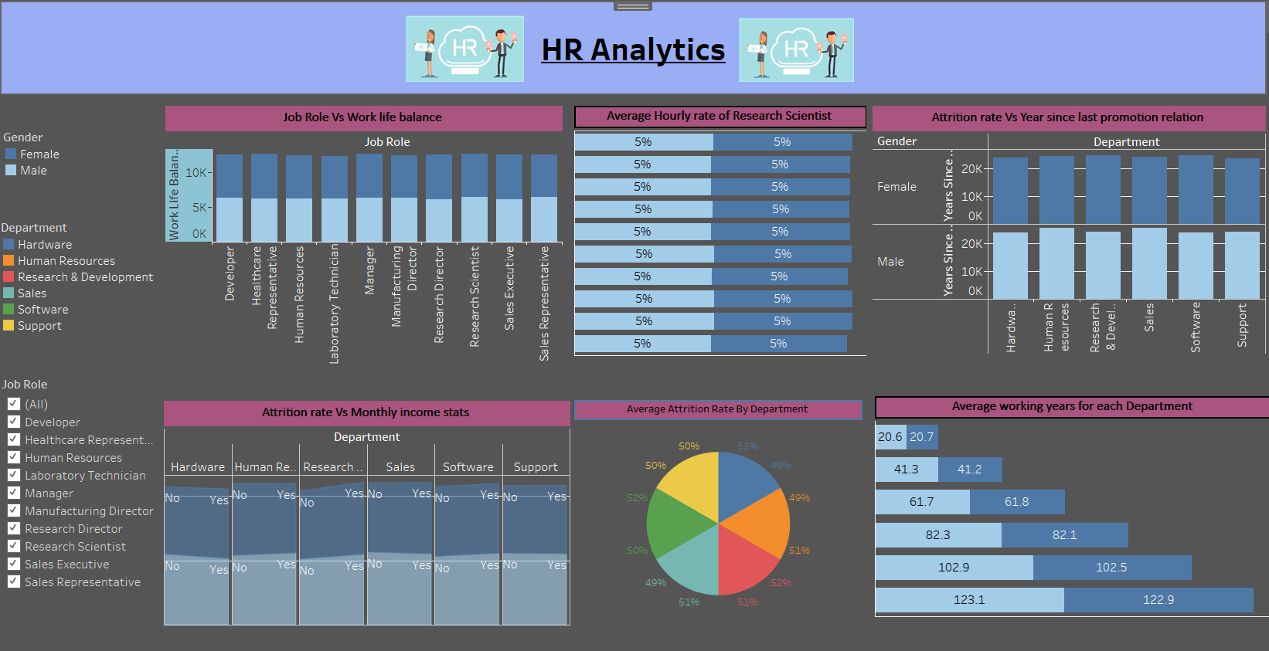

Slide 15
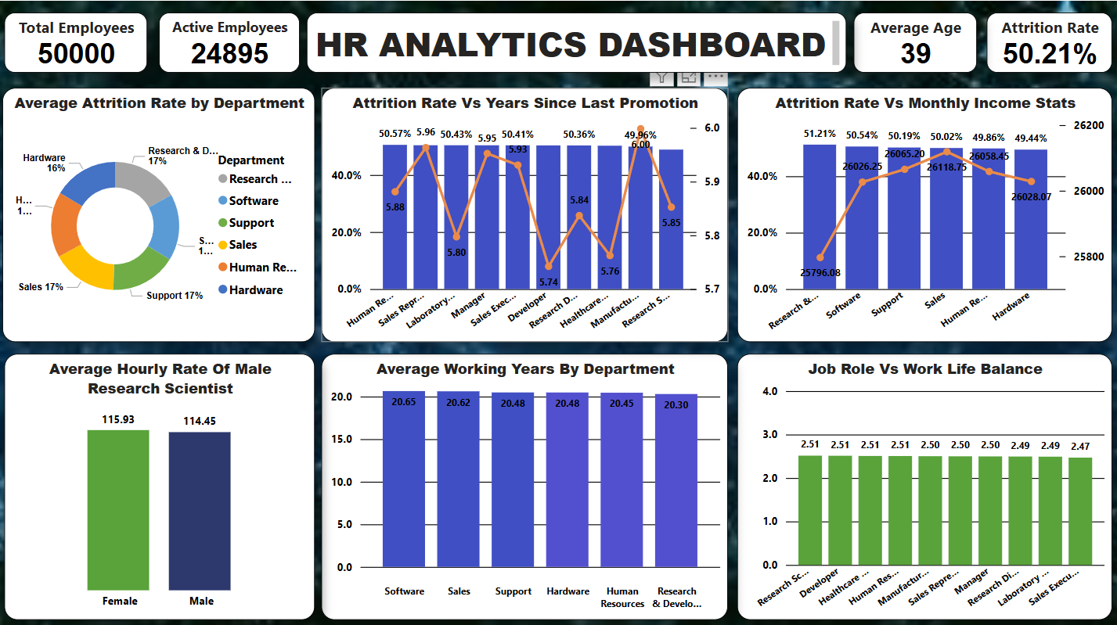

Slide 16
Insights
The average attrition rate across all departments is alarmingly high at approximately 50.21%, indicating a significant organizational challenge that requires immediate attention to improve employee retention.
The average hourly rate of Male Research Scientist is notably higher at 114% Suggesting a Potential gender pay disparity that needs to be addressed for equitable compensation.
The average monthly income across departments show minimal variation, but with attrition rates averaging around 50%, its evident that high turnover is a significant issue regardless for salary levels.
Despite high attrition rates, the average working years across departments remain steady at around 20.5 years, Suggesting that those whose stay tend to have long tenures with the company.
The average work-life balance ratings for various job roles are closely around 2.5, indicating that employees across different positions perceive their work-life balance similarly, with no significant outliers.
Despite a consistent high attrition rate of around 50% across various job roles, the average years since last promotion varies slightly, indicating that factors other than promotion frequency might be influencing employee turnover.
There are multiple factors affecting the attrition.

Slide 17
Recommendation
1) Flexible Work Schedule Allowing employees to have flexible work hours and remote work options increases job satisfaction and work-life balance.
2) Professional Development Opportunities Providing opportunities for learning and growth through training, mentorship, and skill development programs.
3) Recognition and Rewards Implementing a system to recognize and reward employees for their hard work and achievements.
4) Open Communication Channels Creating an environment where employees feel heard and valued through transparent communication channels.
Improving employee retention involves implementing strategic measures to ensure that employees feel supported, valued, and motivated to stay with the company. Offering a flexible work schedule, providing opportunities for professional development, recognizing and rewarding employees, and maintaining open communication channels are key strategies that can significantly impact employee satisfaction and retention rates.

Slide 18
Conclusion
Organization faces a high attrition rate of 50% indicating a critical need to improve employee retention.
Pay disparities particularly among Research Scientist highlight the importance of ensuring fair compensation.
While many employees leave early, those who stay tend to remain long term, suggesting a need to focus on the early employees experience.
Consistent work-life balance issues across roles require company-wide initiatives for improvement.
Addressing these areas comprehensively will help create a more supportive work environment and reduce turnover.
There are multiple factors are affecting the attrition rate are average attrition rate by department, work-life balance, average workings years by department etc.

Slide 19
THANK YOU

